Slide 1
THERAPIQUE “Healing Minds, One Converstaion at a Time”

Slide 2
PRESENTED BY:-
Ishaan Jain CSE-B/61
Rishab Negi CSE-B/78
Tarun CSE-B/70
Archita sinha CSE-B/91
Ayush Rawat CSE-B/76
Saijal CSE-B/90

Slide 3
Table of contents
01
02
Introduction
Business Idea
03
04
Business Model Canvas & Customer Profiling
Marketing Strategy

Slide 4
Table of contents
05
06
Finance Plan & Operational Plan
Challenges & Incorporation,
07
08
CSR
Future Roadmap

Slide 5
01
Introduction

Slide 6
Revolutionizing Mental Healthcare
THERAPIQUE bridges the gap between traditional therapy and modern accessibility, creating India's first truly anonymous, AI-powered mental health ecosystem

Slide 7
Overview
The Mental Health Crisis
86% treatment gap in mental healthcare
₹1.03 trillion economic impact annually
Severe stigma prevents help-seeking
Our Solution Impact
Complete anonymity removes stigma
24/7 accessibility breaks barriers
AI-powered personalization
197 M
Indians with mental disorders
0.75
Psychiatrists per 100,000 people
₹840 Cr
Market opportunity by 2025
40%
Cost reduction vs traditional therapy
100% Anonymous
No personal details required. Complete privacy guaranteed with end-to-end encryption.
Instant Access
Connect with therapists in under 2 minutes. No appointments, no waiting lists.
AI-Enhanced
Smart mood tracking, personalized insights, and predictive mental health analytics.
Affordable Care
Starting at ₹499/session - 60% cheaper than traditional therapy options.

Slide 8
Comprehensive Mental Health Ecosystem
Therapy Modes
AI Features
Wellness Tools
Anonymous text chat
Voice-only sessions
Video consultations
Group therapy rooms
Mood pattern analysis
Crisis detection alerts
Therapist matching algorithm
Progress tracking insights
Guided meditation library
CBT exercise modules
Peer support communities
Emergency helpline
integration
Why THERAPIQUE Will Succeed ?
First-Mover-Anonymous therapy advantage
Proven Model- AstroTalk-inspired success
Tech-Forward- AI-powered personalization
Scalable- Cloud-native architecture

Slide 9

02
Business Idea

Slide 10
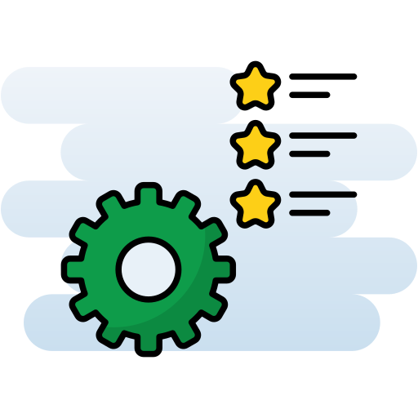


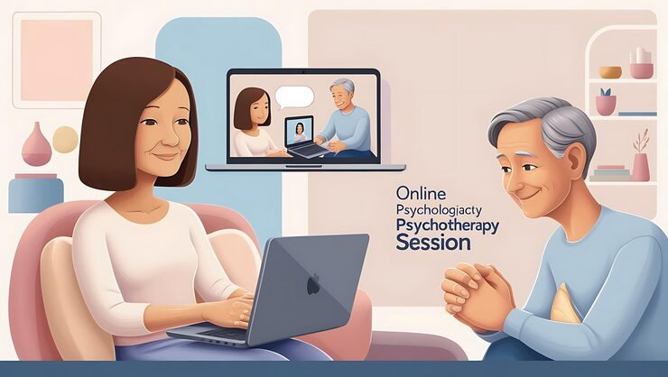

Planned Features:
🎥 Video/audio therapy sessions:
What it is: Live, scheduled sessions with licensed therapists over secure video or audio.
Why it matters: Replicates in-person therapy without travel, saving time and cost.
How it helps: Flexible format—video for richer connection, audio for privacy or low bandwidth; ideal for users with limited time or mobility.
💬 Instant chat with therapists:
What it is: Real-time text-based conversations with a therapist inside the app.
Why it matters: Reduces long wait times; users can get support when stress peaks.
How it helps: Lower barrier to start (typing feels safer for many), discreet in shared homes, and works well on slower networks.

Slide 11


🤖 AI-based daily mood tracker:
What it is: Simple daily check-ins (emojis, sliders, short prompts) that log mood and surface personalized tips.
Why it matters: Builds self-awareness and habit formation; small, consistent steps improve outcomes over time.
How it helps: Sends gentle nudges, identifies patterns (e.g., weekday anxiety), and offers micro-interventions like breathing exercises or journaling prompts.
🕶️ Anonymous therapy option:
Allows users to attend sessions without revealing their identity, helping break the stigma around mental health in India.
How it helps: Encourages first-time help-seeking, especially for students and rural users; preserves dignity and safety with pseudonyms and privacy controls.
📚 Resource library (articles, videos, exercises):
A self-help section with curated mental health articles, short videos, and exercises to support users between sessions.

Slide 12



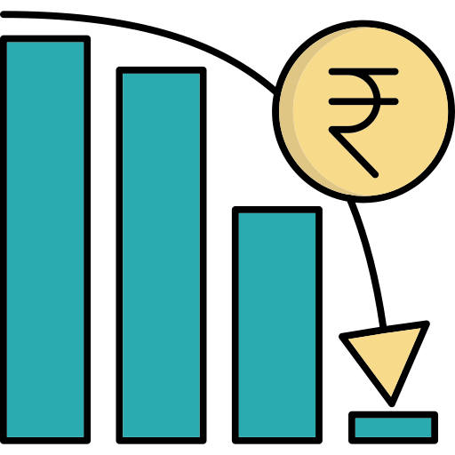


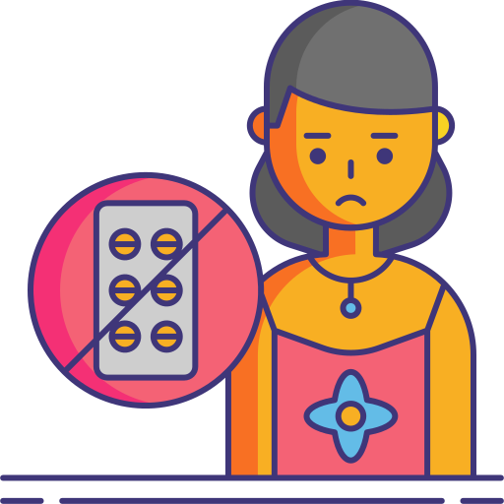


Planned Problems & Solutions
Table format:
Current Problem | Our Planned Solution
Mental health stigma | Anonymous sessions — pseudonyms and private chat/video reduce fear of judgment and encourage first contact.
High therapy costs | Affordable pricing — tiered monthly plans and bundles lower entry cost and support consistent, ongoing care.
Lack of rural therapists | Fully online platform — video/audio/chat remove geography barriers and work on low bandwidth for wider reach.
Long waiting periods | Instant therapist matching — smart routing to next-available qualified therapists enables same-day chat and quicker starts.

Slide 13

03
Business Model Canvas
.

Slide 14
Target Market
.
Students(16-25)
Academic stress, career anxiety, personal stress
Urban Stressed Population
City life pressures
.
PRIMARY
SEGMENT
Working Professional (25-40)
Work-life balance, burnout and anxiety
Rural with Online Access
Limited local resources

Slide 15
Target Market
.
Corporates
Corporates offering wellness benefits
.
SECONDARY
SEGMENT
NGO’S
NGOs focusing upon mental health

Slide 16
Value Proposition & Channels
Value Proposition
.
.
Channels
• Privacy: Anonymous sessions for
stigma-free help
• Accessibility: Available anywhere via
app/website
• Affordability: Lower cost than traditional
therapy
• Certified Therapists: Verified
professionals with relevant expertise
• AI Mood Tracking: Continuous mental
health monitoring
• Digital Platforms: Mobile app,
website
• Social Media: Awareness
campaigns & content marketing
• Partnerships: Corporates,
NGOs, therapist associations

Slide 17
Customer Relationships, Revenue Streams, Key Activities
Customer Relationships
Revenue Streams
.
.
Key Activities
• Personalized Support: Matching with
suitable therapists
• Anonymous Option: Comfort for
hesitant users
• 24/7 Availability: On-demand sessions
& AI chat
• Monthly/Annual subscription plans
• Pay-per-session option
• Corporate wellness packages
• Platform development &
maintenance
• Onboarding & verifying therapists
• Marketing & awareness
campaigns
• AI mood tracking model
improvement

Slide 18
Key Resources, Key Partners, Cost Structure
Key Resources
Key Partners
.
.
Cost Structure
• Certified therapists & counselors
• Tech development team
• AI-based mood tracking tools
• Marketing & community outreach
team
• NGOs working on mental health
awareness
• Therapist associations & universities
• Corporates for employee wellness
tie-ups
• Salaries (therapists, tech,
marketing)
• Technology maintenance &
hosting
• Marketing & partnerships
• Licensing & compliance

Slide 19

04
Marketing Strategy: 4Ps and Competitive Analysis.
.

Slide 20




Marketing Strategy (4Ps)
Product:
Price:
Anonymous therapy through video, audio, and chat for stigma-free, private access.
AI-powered mood tracker and self-help library (articles, exercises, guides) to provide continuous support between therapy sessions.
Affordable tiers to widen access: ₹499/session to ₹999/session, and ₹4,999 corporate wellness package, undercutting typical online therapy ranges in India and global apps.
Benchmark: BetterHelp ~₹21,660–₹29,729/month; Talkspace ~₹5,400–₹9,545/week equivalent, highlighting strong value
Place:
Mobile app (iOS/Android) and Web portal for nationwide reach; WhatsApp bot for simple, low-data access in rural/first-time user contexts.
Promotion:
Social media campaigns, influencer tie-ups, campus drives, and LinkedIn HR outreach to build youth trust and drive corporate adoption.

Slide 21
Competitive Analysis
Table format:
Platform | Anonymous Sessions | AI Mood Tracker | Pricing (₹) | Localized (India) | Corporate Wellness
YourDost | ❌ | ❌ | ~₹800 –₹2,070/session | ✅ | ✅Limited (Institution MoUs)
BetterHelp | ❌ | ❌ | ~₹21,660 –₹29,729/month | ❌ Global-only | ❌
Talkspace | ❌ | ❌ | ~₹5,400 –₹9,545/week | ❌ Global-only | ❌
THERAPIQUE | ✅ | ✅ | ₹499 – ₹999/session | ✅ | ✅Corporate plan

Slide 22
05
Finance & Operational Plan
.

Slide 23
Finance Plan
Initial Capital -
₹18 lakhs invested initially for platform development, therapist onboarding, marketing, and operational setup.
Revenue Forecast
Key Financial Terms
Year | Projected Revenue
Year1 | ₹8 lakh
Year2 | ₹20 lakh
Year3 | ₹40 lakh
Capital – The total amount of money invested to start and run the business (e.g., ₹18 lakh initial investment).
ROI (Return on Investment) – The percentage of profit earned compared to the total investment.
Break-even – The stage where total revenue equals total costs, and the business starts making profit.
Revenue – The total income generated from customers before expenses are deducted.

Slide 24
Revenue Growth Projection

Slide 25
Operational Plan
👩‍⚕️ Key Resources
📍 Location
• 20 Certified Therapists
• Tech Dev Team (3–5)
• AI Chatbot
• Cloud Servers
• Fully online HQ
• Cloud-based hosting
• Nationwide clients
🤝 Strategic Partners
• NGOs – awareness
• Mental Health Assoc.
• Corporate HR tie-ups

Slide 26
⚙️ Workflow
Therapist Onboarding
1
Platform Development
3
AI Model Training
2
Marketing & Outreach
5
4
Customer Support

Slide 27
06
Challenges & Incorporation
.

Slide 28
Challenges
Data Privacy
User Trust
Protecting sensitive user information with end-to-end encryption.
Making People comfortable to open up online.
Therapist Licensing
Funding & Scale
Ensuring only certified, qualified therapist onboard.
Balancing financial sustainability with Social impact.

Slide 29
Incorporation
Company Type
Name Approval
MOA & AOA
File Incorporation
PAN & TAN
GST
Register as Pvt Ltd.
Apply via MCA portal.
Draft objectives & rules.
Submit docs online.
Get tax registrations.
Register if turnover > ₹20L

Slide 30
07
Corporate Social Responsibilty
.

Slide 31
Free Sessions for Students
Awarenes Campaigns
Community Partnerships
Support during academic stress & crises.
Break Stigma with webinars & workflows.
Work with NGOs, Schools, and Colleges.

Slide 32
08
Future Roadmap
.

Slide 33
Future Roadmap
Foundations
Diversification
1
Expansion
3
Ecosystem Vision
Secure platform launch, onboard certified therapists, early adopters.
2
Offline therapy hubs in metros, AI-powered diagnostics for early screening.
4
Multilingual therapy, corporate wellness tie-ups, strong brand trust.
Expand into preventive care – meditaion, group therapy, stress workshops.

Slide 34
Thanks!

